Slide 1
Audio Amplifier
Under the supervision of Dr. Said Emam and Eng. Engy Georgy

Slide 2
Our Team
Abdallah Mohamed Mohamed Galal
Abdelrahman Salah El-dein Abdelaziz
Mohamed Ahmed Mohamed Hassan
Farida Waheed Abd El Bary
Razan Ahmed Fawzy

Slide 3
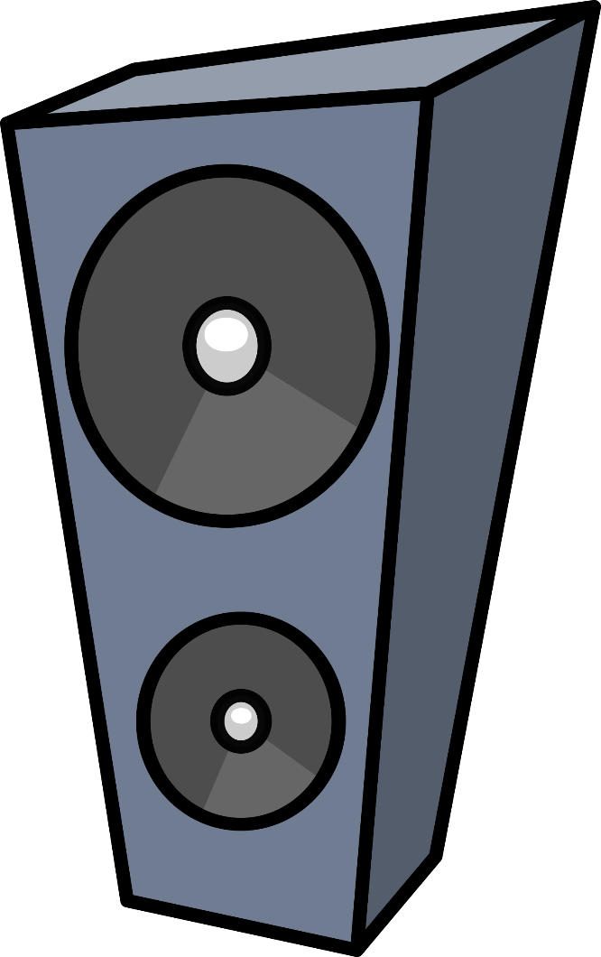
The Project's Objectives
is to faithfully, effectively, and with minimal distortion recreate input audio signals at sound-producing output elements at required volume and power levels.

Slide 4
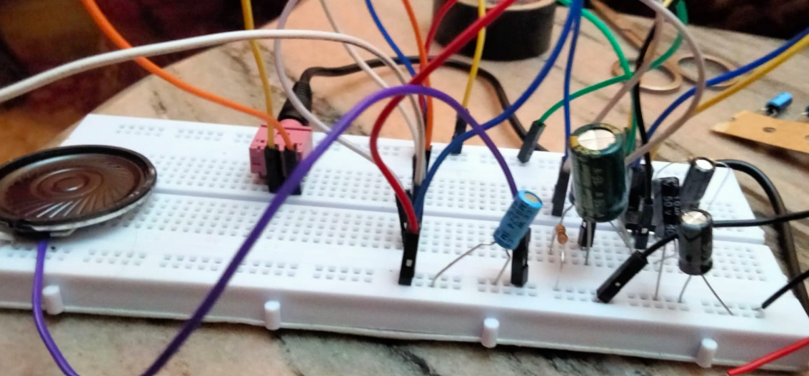
Audio Amplifier
Any electronic device that amplifies an electrical signal whose vibrations fall within the audio frequency range, or the range that people can hear, is known as an audio amplifier.

Slide 5
PROJECT STAGES
01
02
03
Design the project by deciding on its constituent parts and assigning them appropriate values.
To test it, place our circuit on one of the simulator programmers, proteus.
The practical process then begins.

Slide 6

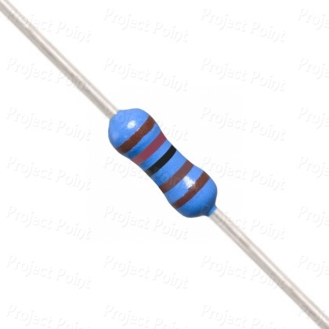
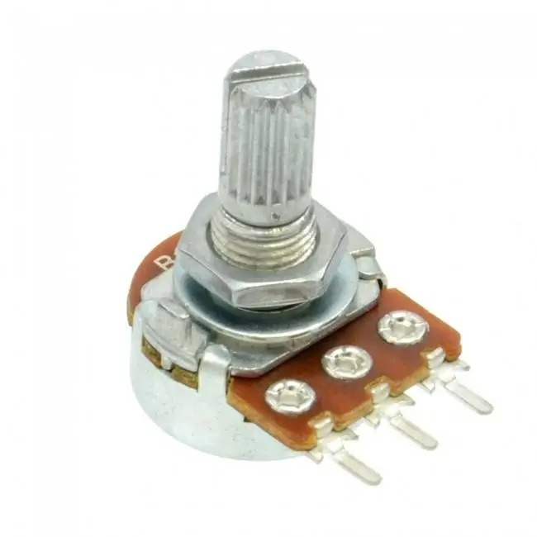
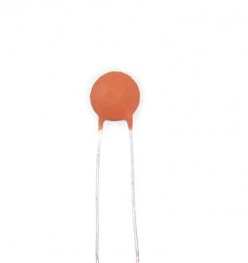
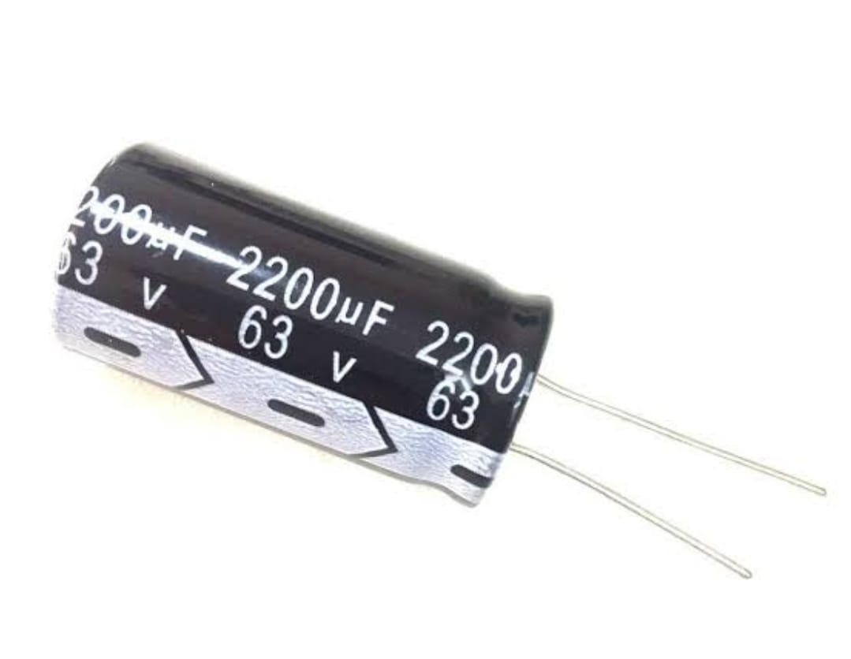
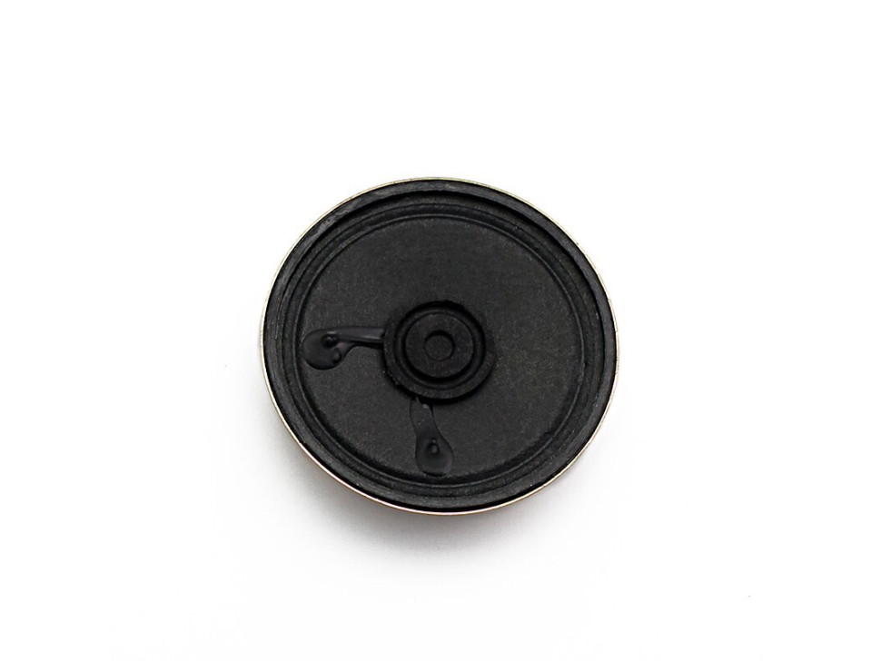
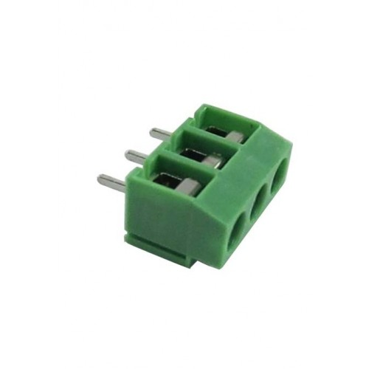
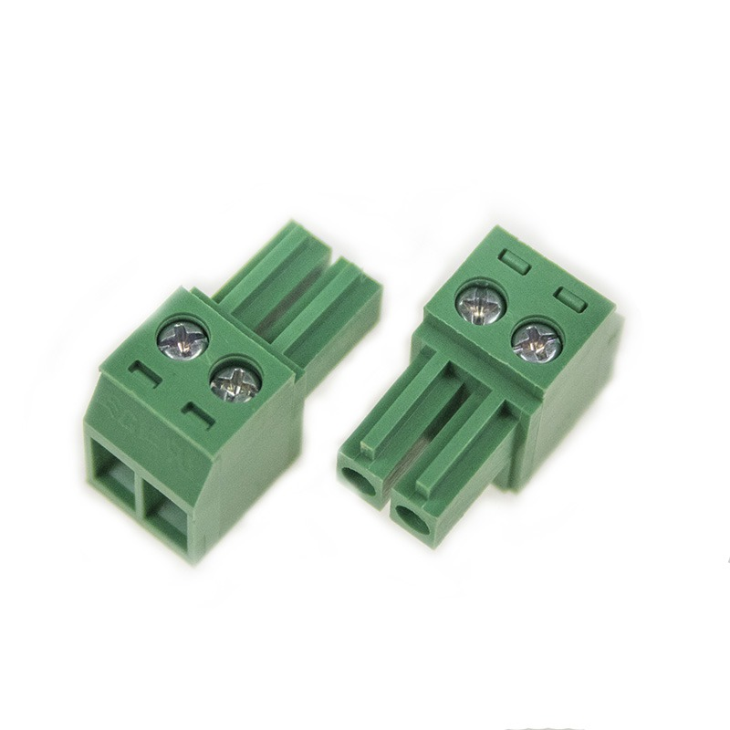
TABLE OF COMPONENTS
Switch
Resistor
Potentiometer
Capacitor
Speaker
Terminal Connectors
It’s value and number used in the project: ON/OFF Rocker Switch, 1 Switch.
It’s value and number used in the project: 1.2K ohm, 10 ohm 7w, 1K ohm (2), 4 Resistors.
It’s value and number used in the project: 10K ohm, 1 Potentiometer.
It’s value and number used in the project: 10nf, 1000uf, 10uf (2), 0.1uf (2), 100uf, 7 Capacitors.
It’s value and number used in the project: 8ohm 0.5w, 1 Speaker.
It’s value and number used in the project: 3-pin, 2-pin, 2 Terminal Block Connectors.

Slide 7
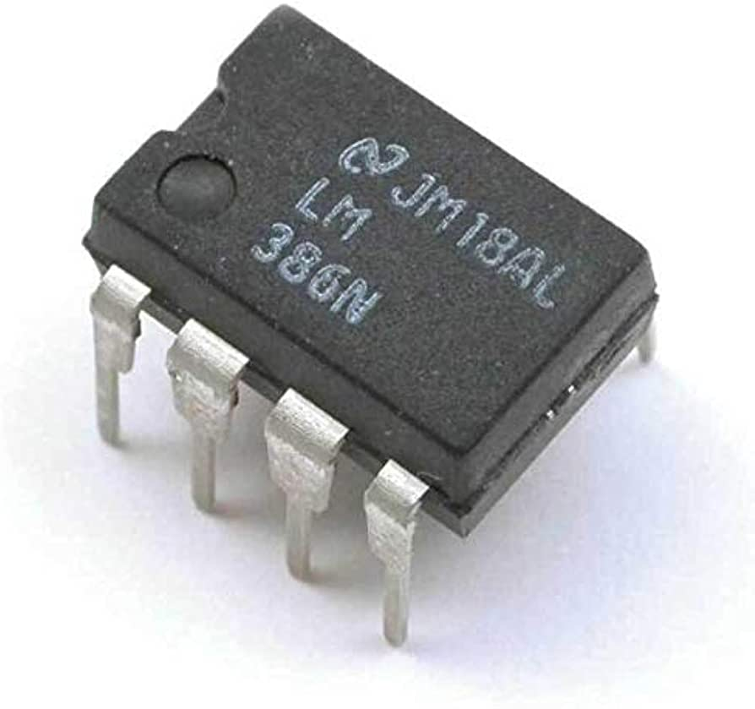
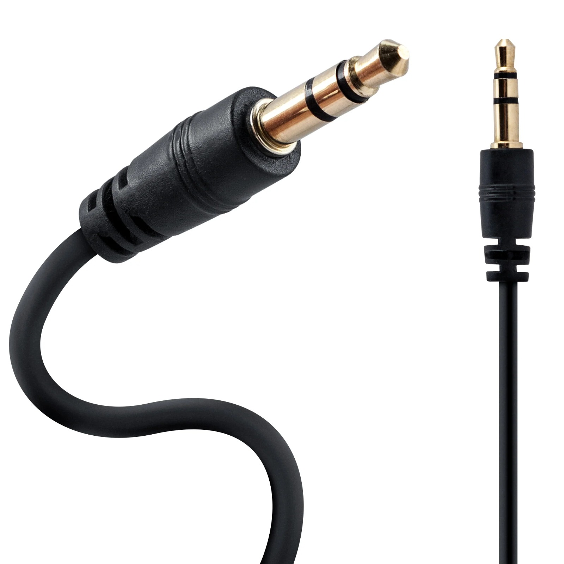
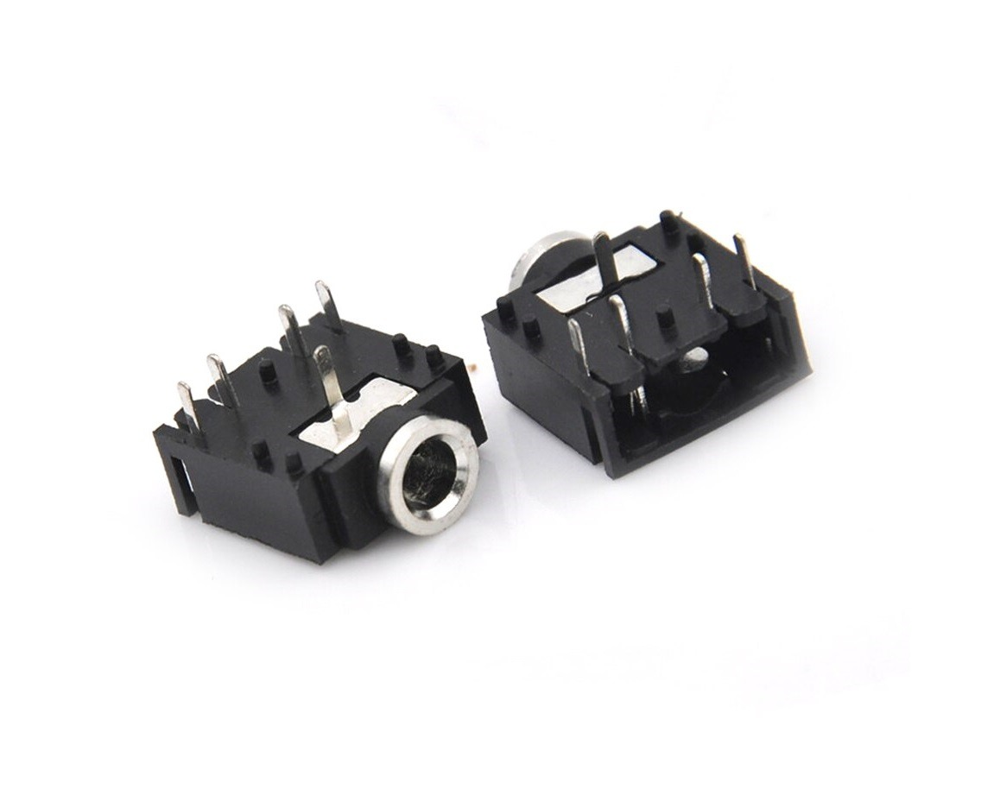
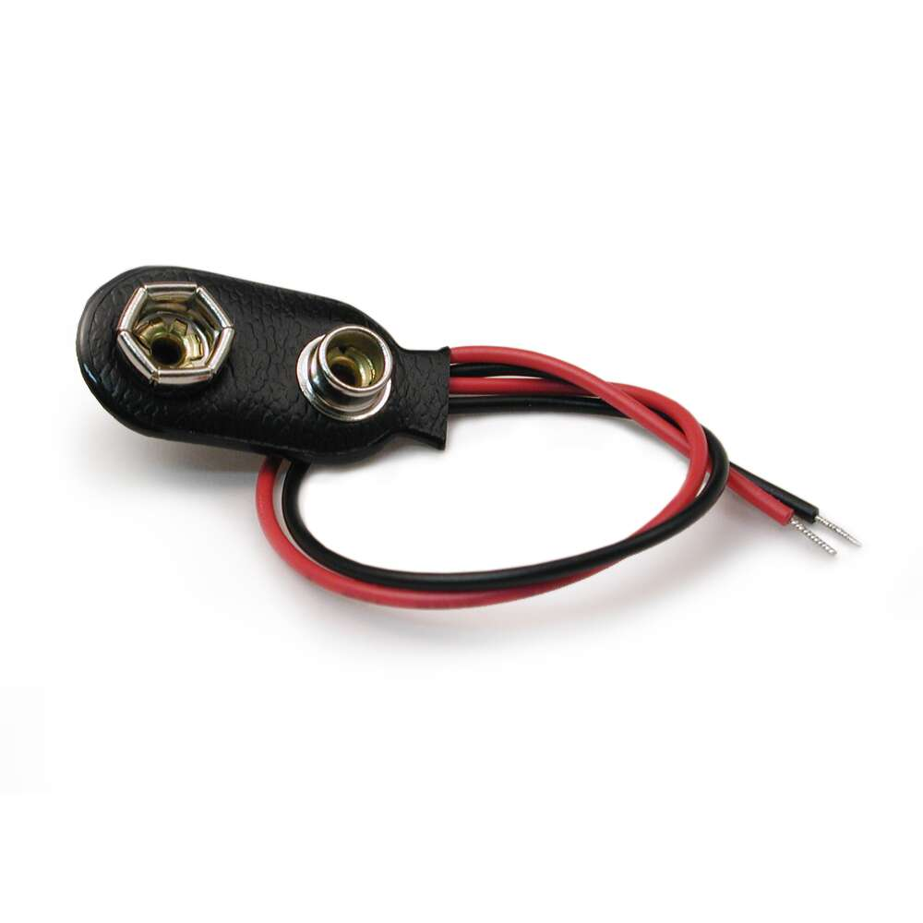
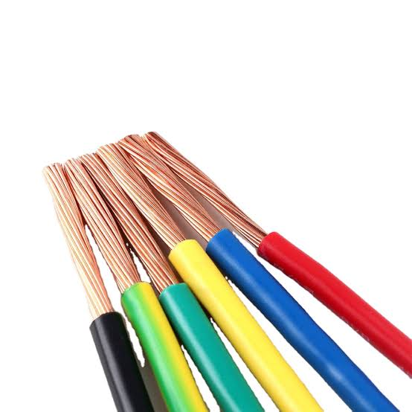
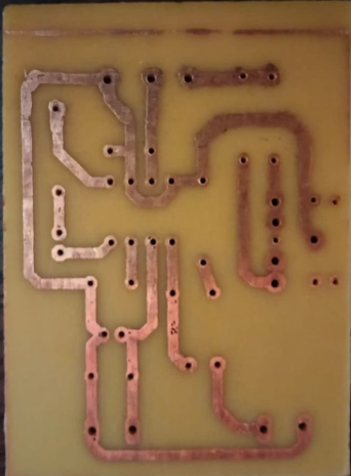

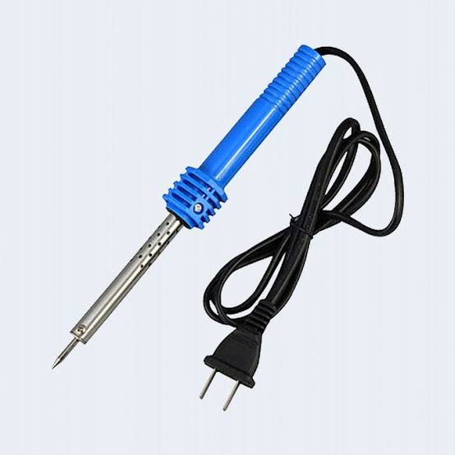
TABLE OF COMPONENTS
LM386
Female AUX Jack
Battery Connector
Wires
PCB Board
Soldering Iron
AUX Cord
Battery
It’s value and number used in the project: 9V, 1 Battery.

Slide 8


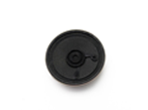
SMALL HINT ON EACH COMPONENT
LM386
It is an integrated circuit for a low-voltage audio power amplifier. And it is thought to be among the most popular and fairly priced integrated circuits (ICs) that function as speakers..
It creates sound waves from the analogue or digital inputs it receives from computers or audio players. It can be used in many situations where space is limited because of its tiny size.

Slide 9


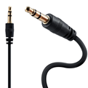
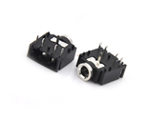
SMALL HINT ON EACH COMPONENT
Battery
Battery Connector
AUX Cord
Female AUX Jack
It immediately transforms the chemical energy contained in its active components into electric energy.
The purpose of battery connectors is to connect a battery in a small electronic product.
The cord that you used to use to connect your phone to the speakers.
It is a little phone jack that links any portable music player to the amplifier and speakers of the car.

Slide 10
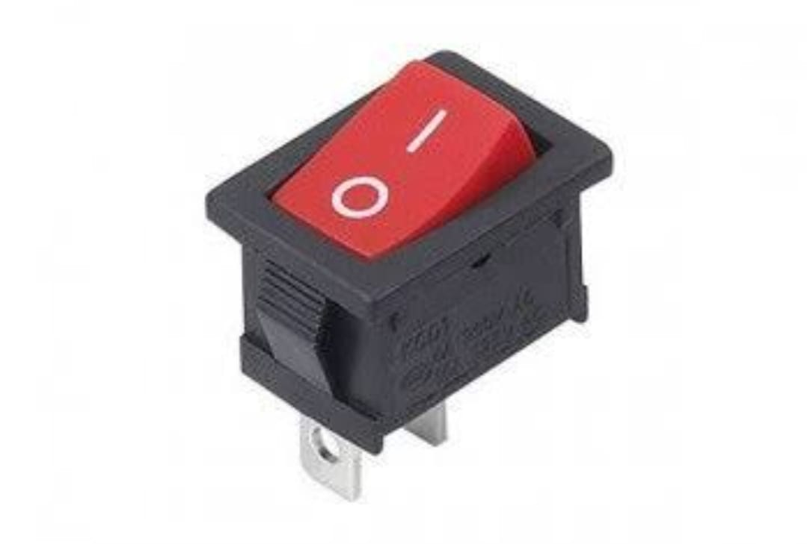



SMALL HINT ON EACH COMPONENT
Switch
Capacitor
Resistor
Potentiometer
It is a tool for opening and closing electric circuits.
It is a passive electronic component with the ability to store electrical charge-based energy.
It is a two-terminal passive electrical component used to control the amount of current flowing through electrical circuits.
It is a three-terminal resistor with a spinning contact that functions as a passive electrical component to provide a voltage divider that is programmable.

Slide 11
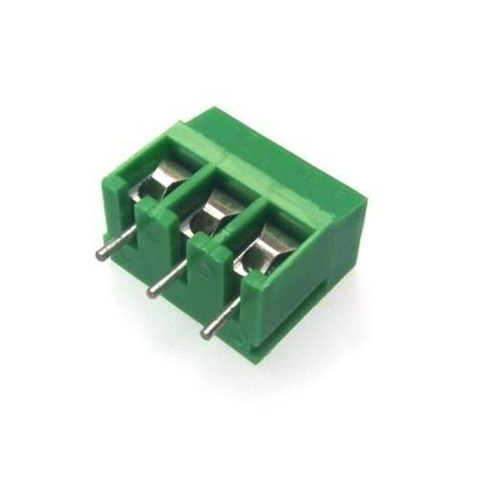
SMALL HINT ON EACH COMPONENT
Wires
Soldering Iron
Terminal Connectors
PCB
It is a hand-held instrument for soldering. It provides the heat necessary to melt the solder and allow it to flow into the joint between two workpieces.
An electrical part used to connect appliances to a power source or utility is a power cord.
A connector is a component that connects two pieces of machinery, wiring, or piping.
It is a method used in electrical and electronic engineering to safely link electronic parts to one another.

Slide 12
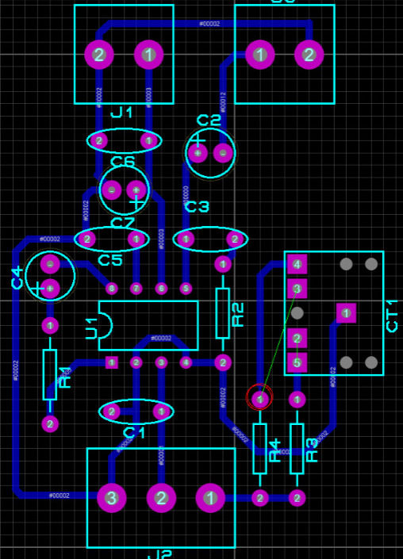
THE DESIGN ON PCB
After designing the circuit and placing it on the Proteus simulator tool, we printed our design on the PCB.

Slide 13
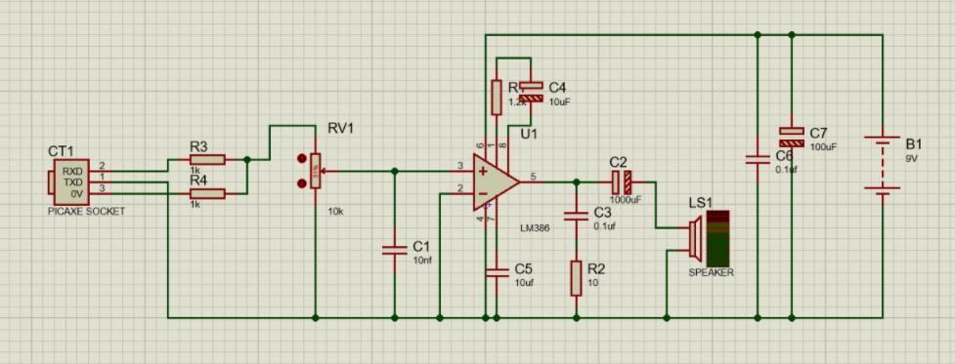
THE DESIGN ON PROTEUS

Slide 14
FOLLOWING THAT
SECOND
FIRST
THERID
We went on and purchase our components.
Then using the aux to connect the phone to the speakers to play a song to make sure it works.
After that, we used a soldering iron to connect the components on the PCB.

Slide 15
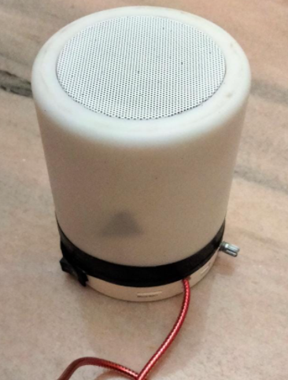
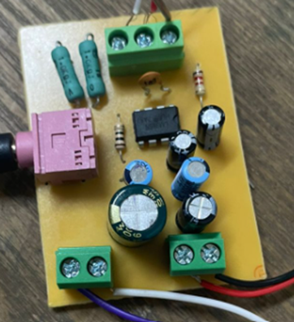
Its outer shape.
The inner components.

Slide 16
THANKS!

